Slide 1
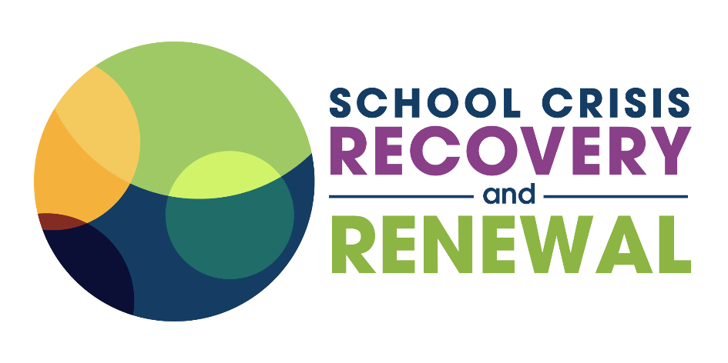
Trauma Informed
School Systems for Crisis Recovery and Renewal
A curriculum developed by School Crisis Recovery and Renewal Field Coach, Brianna Young
Published 2025
This deck is annotated for facilitators’ use; facilitation guidance is shared on Slides 2-3, with specific training notes in the notes section of each slide (timing, moves).
The workshop’s content begins on Slide 5.
Suggested citation:
Young, B. (2023). Trauma Informed School Systems for Crisis Recovery & Renewal, [Online workshop]. Training content for the School Crisis Recovery & Renewal project, NCTSN, SAMHSA, Washington, D.C.
Notes:
Timing <1 minute
Facilitation Notes:
Offer a welcome and gratitude for those who are present, can have this displayed as people come into the room
Option: add a visual countdown timer for prompt as to when the session will start

Slide 2
Facilitation Guidance
Dear School Crisis Recovery & Renewal Leaders,
Welcome to Trauma-Informed School Systems for Crisis Recovery and Renewal, a learning experience built with you in mind—educators, administrators, mental health professionals, and school staff — and or anyone who holds others through some of the most painful moments in a school community’s life.
This content was developed through the School Crisis Recovery and Renewal (SCRR) project, a National Traumatic Stress Network Category II site funded from 2020-2025.
SCRR’s work was and is informed by leading voices in trauma and grief, including Dr. Judith Herman, whose framework of trauma recovery continues to shape healing practices, David Kessler, who reminds us of the power of meaning-making through grief, and Dr. Leora Wolf-Prusan for holding this vision and constructing this framework. Together, their work, along with the lived experiences of schools across the country, shapes this curriculum.
In moments of crisis—whether it's the death of a student, a community tragedy, a natural disaster, or ongoing collective trauma—leaders like you are often asked to keep going, to show up, and to make decisions, all while navigating your own emotional responses. This learning space is an invitation to slow down, reflect, and reimagine how your school system can be a source of healing—not just harm prevention.
The content in this deck is about more than responding to crisis—it is about recovering and renewing with intention, compassion, and justice. We hope it provides clarity and stability to your experience, provides you with a shared language, and serves as a resource to support others who navigate crises alongside you.
We see you. We value the labor you do in the aftermath. And we are honored to support your efforts to cultivate trauma-informed, healing-centered schools where both students and adults can recover and thrive.
In partnership,
Brianna Young, M.Ed SCRR Field Coach www.schoolcrisishealing.org

Slide 3
Facilitation Guidance Continued
This workshop deck and facilitation guidance is meant to be flexible and responsive. Here are some suggestions for how to engage with the materials.
Intended Workshop Audience
Principals and administrators; Mental health professionals and student support staff; Teacher leaders and crisis response teams; District-level staff and decision-makers; Facilitators, training and technical assistance providers, instructional coaches; and Anyone interested!
Intended Modality
This workshop’s deck is designed for a 2-hour, virtual training open to any sign ups. It can be adapted for in - person and customized for specific teams.
How to Use This Deck
Facilitated Workshop: Use in professional learning sessions for school or district teams. The notes provide facilitation prompts, timing, and reflection activities.
Self-Study or Leadership Coaching: Leaders may review the deck independently or with a coach to reflect on their crisis leadership style and recovery practices.
Team Reflection Tool: Use breakout discussions, journaling prompts, or the Application Grid at the end to support planning and shared commitments.
Supplement to Existing Crisis Plans: Layer the recovery and renewal lens onto your school’s current crisis response plan, especially in the weeks and months after the “event.”
Here is a YouTube link to a recorded session of TISS (2023) that you can use for reference
Guiding Principles
Slow is fast. Recovery and renewal take time. Prioritize relationships and process over immediate fixes.
Both/And Thinking: Healing work lives in generative tension —between grief and hope, harm and resilience, rupture and repair.
You deserve care, too. Leaders cannot lead recovery without tending to their own needs. These materials also support you, not just your students.
For Facilitators
As you prepare to facilitate, in the notes you will see “Timing” to support your pacing, “Say” that denotes a script you might follow, and then either italicized text that indicates facilitation moves to make as you present, or “Facilitation Notes” on the different structured activities.
This training takes about 2 - 2.5 hours, depending on how long you allow conversations. It was originally facilitated in 2-hours in a virtual setting, so in person may require additional time considerations. We note that in our post-session feedback surveys, participants frequently shared that they wanted more time.
The materials you need are linked in the speaker notes (such as the reflection grid for the closing activity).
Graphics and template branding can be adapted as long as the content is properly cited (see previous page).

Slide 4
WHAT IS SCRR?
Promoting effective and sustainable change in the ways school communities and school leadership builds the skills, knowledge, and attributes necessary to recover and renew after a crisis.
www.schoolcrisishealing.org
School crisis readiness is essential. Response is critical.
And: what happens after matters, too.
Notes:
Timing: <1 minute
Say: The School Crisis Recovery and Renewal (SCRR) project supports educators, school staff, and school-based clinicians to effectively implement trauma-informed crisis response, recovery, and renewal strategies. As a SAMHSA grant recipient, this work concluded in May 2025 but its resources are still available for you. Our work will always be dedicated to the school crisis leaders at all levels.

Slide 5
Trauma Informed
School Systems for Crisis Recovery and Renewal
A curriculum developed by School Crisis Recovery and Renewal project Field Coach, Brianna Young
(Date)
Notes:
Timing <1 minute
Facilitation Notes:
Offer a welcome and gratitude for those who are present, can have this displayed as people come into the room
Option: add a visual countdown timer for prompt as to when the session will start

Slide 6
LET’S CONNECT!
Introduce yourself, sharing your name, role, and your response to the question!
Notes:
Timing: 5 minutes
Say: Let’s take a moment to connect to each other! Say hello to the people around you and share your answer to the question: Share a question from the list of options below:
If you were an ice cream flavor, which would you be and why?
What animal reflects your mood today?
If you suddenly found yourself in a book or movie, which one you want to land in?
If you could teleport anywhere for lunch, where are you going and what are you eating?
If your name had to be a verb, what would it mean to 'you'?
You’ve just been handed a golden ticket—what does it grant you access to?
If you had a personal logo, what symbol or image would it include?
Facilitation Notes
If facilitating virtually, this can be done in the chat or in small breakout groups of 2-3 people

Slide 7
AGENDA
Part One: Impacts of Stress + Trauma
Trauma-Informed Principles
Defining Terms
School + Society Considerations
Part Two: School Crisis Recovery + Renewal Foundations
Elements of Recovery
Moving Toward Renewal
Part Three: Application
What might we start, stop, sustain, and scale?
Notes:
Timing: ~1 minute
Say: This is the basic outline of our conversation today - we will start by exploring the impacts of stress and trauma and how our school communities are impacted, inviting us to reflect on mindset shifts we might adopt to better address what we see in the face of crisis.
Then we explore the foundational elements of school crisis recovery and renewal by looking at each element we observe in the weeks and months after a big thing happens.
We finally close with a chance to piece it all together and make meaning of the training, and I will provide a framework for us to plan actionable steps we might take to apply this learning.

Slide 8



OUR OBJECTIVES
Be able to distinguish between stress, trauma and grief, and connect those concepts to their personal and professional experiences in school communities navigating the pandemic and other crisis events.
Identify ways socio-cultural trauma can impact other types of stress, trauma, and grief, as well as ways that sociocultural relationships like community and culture can support healing- within and in the ecosystems of schools.
Apply the principles of school crisis recovery and renewal to educator pedagogical practice, classroom environment, school site and system leadership, and larger school culture.
Notes:
Timing: <2 minutes
Say: Let’s review our purpose here together. These objectives anchor us to the conversation and guide the conversations we will have today. Read objectives on slide.

Slide 9

(Salzman & Salzman, 2015)
Notes:
Timing: 4 minutes
Say: Before we begin, let’s take a moment to get settled. So often, we stay disintegrated - our brains going one way and our bodies running toward another. The power of a breath can help, and who better to learn it from than students. This video is a short film from Mindful Schools, directed by Josh Salzman and Julie Bayer Salzman, where students reflect on the power of their breath. Let’s watch.
Citation: Salzman, J. B., & Salzman, J. (2015, February 27). Just Breathe [Video]. YouTube. https://www.youtube.com/watch?v=RVA2N6tX2c

Slide 10



STRESS, TRAUMA, GRIEF & CRISIS IMPACT PEOPLE AND SYSTEMS
Teacher
Classroom and School Systems
Students
Notes:
Timing: 2 minutes
Say: As we move through this conversation, you will notice the conversation moves between individual experiences, collective experiences, and system experiences. This is because stress, trauma, grief and crisis impact people and systems, and to bring about healing-centered change, we need to consider both. We also see these happen at both a macro level (such as a student death by suicide or a natural disaster) and a micro level (like a student conflict in the hallway or the ending of a social group) that being about the feelings of stress, grief and trauma. The intensity and duration alters the scale of the impact, yet there is still impact.

Slide 11






Principles of A Trauma-Informed School
Social Justice
Collaboration, Peer Support & Mutuality
Safety & Stability
Trustworthiness & Transparency
Empowerment, Voice & Choice
Resilience, Growth, & Change
Notes:
Timing: 5 minutes
Say: These are the core guiding principles of a trauma informed system. As we reflect on recovery and renewal, and healing from a crisis, you will see where each of these tenets plays a role. The first two are able deepening our understanding and broadening our lens. From there we see practical strategies that empower us to act upon our increased knowledge. These are woven throughout the response to a crisis, as well as recovering from it and renewing after it. This principles become a collective approach to how we are together, as opposed to a checklist of things to do.
Facilitation Notes: This can be a spot where you survey the room with participants indicating how familiar they are with these principles, by showing a 1-5 on their hand (1- new to this and don’t know these, 5- I feel like I am an expert in these and integrate them all seamlessly). If participants are all generally familiar, you can do a quick overview, and if not, you might want to go more in depth on the principles. For personal reference, you can review SAMHSA’s principles document here, as these principles are adapted from this framework.
Notes: Here is a brief summary of each of the principles with an example:
Social justice involves attending to the diverse needs of the communities that are served, attending to issues of historical and present injustice as we provide support and care. This looks like addressing racial disparities in access to care or affirming supports for queer students).
Collaboration, Peer Support & Mutuality is knowing that healing happens in relationships and in the meaningful sharing of power and decision-making. This include relationships with other trauma-survivors. This can take the form of peer support groups or mentoring relationships.
Safety and Stability is about creating predictability and attending to physical and psychological safety, co-creating what safety looks like in each space. This can be discussion or meeting norms when potentially activating topics might come up.
Trustworthiness and Transparency addresses the importance of open communication as a vehicle for strong relationships and trust. Consistency and clear communication help promote a sense of trust within an organization. This looks like giving people a heads up if changes are coming to a schedule or seeking input before a decision is made.
Empowerment, Voice, & Choice means that individuals strengths are recognized and built upon, and people in the organization have a real opportunity to make informed decisions about what happens to them. This attends to power differentials and a democratic approach whenever possible. This looks like education on treatment options so a patient can make an informed choice, or creating ways students might have agency over their learning experience.
Resilience, Growth, and Change is an affirmation of the individual and community assets as a means of healing, placing an emphasis on the tangible steps that can be taken to move toward healing. This could mean being involved in community activism or engaging with cultural elders to find support.

Slide 12
Chat & Consider…
Vent diagram exercise: recognize and reckon with contradictions and keep imagining and acting from the intersections and overlaps.
What feels affirming or celebratory about trauma- informed principles?
What feels impossible or dichotomous in working toward implementing them?
Source: ventdiagrams.com
Notes:
Timing: 2 minutes
Say: I want to start us off with a conversation that acknowledge the tensions we feel in the work. This activity, called Vent Diagrams, is a collaborative social media and art project started by educator E.M./Elana Eisen-Markowitz and artist Rachel Schragis. We define a “vent diagram” as a diagram of the overlap of two statements that appear to be true and appear to be contradictory. We purposefully don’t label the overlapping middle. Making vent diagrams as a practice helps us recognize and reckon with contradictions and keep imagining and acting from the intersections and overlaps. Venting is an emotional release, an outlet for our anger, frustration, despair -- and as a vent enables stale, suffocating air to flow out, it allows new fresh air to cycle in and through. We’re trying to make “vents” in both senses of the word: tiny windows for building unity and power, emotional releases of stale binary thinking in order to open up a trickle of fresh ideas and air.
Source: ventdiagrams.com

Slide 13


Samples from the archive of ventdiagrams.com
Notes:
Timing: 1 minute
Say: Let’s take a look at an example of this. At a workshop, teachers grappled with the challenge of racial inequity in their school, and we can see from these examples the seemingly opposite statements that both are true. Read the statements.

Slide 14

Chat & Consider…
Vent diagram exercise: recognize and reckon with contradictions and keep imagining and acting from the intersections and overlaps.
What feels affirming or celebratory about trauma- informed principles?
What feels impossible or dichotomous in working toward implementing them?
8 minutes in breakout rooms
Notes:
Timing: 10 minutes
Say: So now I want to give you space to discuss your own “vents” in small groups. In conversation, explore the dichotomies you run into in your work that are true as it relates to becoming more trauma-informed.
Facilitation Notes:
Groups of 4-5 depending on the set-up of the room, either physically move together or into breakout rooms on Zoom
If facilitating to a small group you can also keep everyone together, have them type their “vents” in the chat, then call out a few for discussion in the whole group.

Slide 15
What happens to us in a crisis?
STRESS
TRAUMA
GRIEF
Stress is the feeling of being overwhelmed with mental or emotional pressure.
Overwhelming demands placed upon the physiological/ psychological system that lead to a profound sense of loss of control and helplessness
Grief is a strong, sometimes overwhelming emotion for people, stemming from a sense of loss
Notes:
Timing: 2 min
Say: As we consider the experiences that happen during a school crisis, both at the macro and micro level, we often encounter these three things: stress (the feeling of being overwhelmed with mental or emotional pressure) , trauma (overwhelming demands placed upon the physiological/ psychological system that lead to a profound sense of loss of control and helplessness), and grief (a strong, sometimes overwhelming emotion for people, stemming from a sense of loss). They are related and interconnected, yet distinct and unique experiences that can be felt across our school communities. Let’s explore what each of these looks like in more detail.

Slide 16

STRESS: Manageable Challenge or Overwhelming Threat?
CHALLENGE
THREAT
Perceived resources
Perceived stressor
Perceived resources
Perceived stressor
Notes:
Timing: 3 minutes
Say: We all experience stress, and not all stress is harmful for us. When our resources and our stressors are balanced, or if we have more resources than stressors, we can experience that as a manageable challenge. When stressors exceed our resources (this may be actual resources, it may be perceived), it can create a threat response in our bodies, we stay in a state of activation, and the body doesn’t have a chance to recover. These are often unpredictable, meaning we may have low control over changing the stressor.
When you or someone else is struggling, you might ask: is there a way we can decrease these stressors, and is there a way we can help build resources? Sometimes there is a lot out of our control, but wherever we can make shifts in these, it can shift the balance. We have inequitable access to resources all the time based on the systems of oppression in our country/the world. And access to resources like housing, healthcare, food, financial stability impact our safety and wellbeing, and move things that might have otherwise been a challenge we can manage into an overwhelming threat.
One example might be how two different students navigate the divorce of their parents. Imagine one kid has a strong friend group, mentors, and access to stable resources, while the other loses all stability when the financially secure parent decides to leave the family. The tools at their disposal are different and how one child navigates this experience might look drastically different.

Slide 17
TRAUMA is an Event, Experience, & Effect
Event
Actual danger or extreme threat of harm
“Fight, flight or freeze”
Helpless to escape
Experience
Overwhelms brain and body
Dis-integration
Dysregulation
Effect
Lasting adverse effects
(Herman, 2015; Van der Kolk, 2005; DSM-5; Fleitas, 2019; Siegel, 2012; Bloom, 2013)
Notes:
Timing: 3 minutes
Say: One way to define trauma is “event, experience, and effect.” Event is an actual danger or extreme threat of harm (can be experienced directly or indirectly). It can be something we witness, experience firsthand, or even sometimes have the threat that may happen to us (like a soldier waiting for an imminent attack).
Within that event, we have an experience. When we are under threat, our brains and bodies mobilize into a “fight, flight, freeze, or fawn” response. These are natural, instinctual, protective reactions our body engages in to keep us safe. We either puff up to make the threat go away through words or actions (our fight response), run away to evade the threat (our flight response), immobilize or numb out to avoid the threat like a deer in headlights (freeze response), or seek to go along or appease the threat so that we stay safe (this is the newer emerging “fawn” or “appease” response.
But despite our efforts, we can feel or may be helpless to escape the traumatic event. This overwhelms our brain and body that leads to a dis-integration of the parts of our brain and body that normally work well together. This looks like dysregulation, which is a loss in capacity to modulate internal states—stress arousal and emotional states. This can have lasting adverse effects - from social to physical to psychological outcomes - such as anxiety, heart or kidney problems, or trouble maintaining relationships.

Slide 18
GRIEF: Experiencing a Sense of Loss
Loss is relative, loss is complex.
Death of a meaningful person
Ritual/routine/habit
Life transitions
Perception/feelings
Not all grief involves trauma, but all trauma involves grief.
Grief really is that feeling that you have, the sort of intensity that just overwhelms you, and that sort of momentary experience. Grieving, on the other hand, is the way that grief changes over time without ever actually going away.
-Mary Frances O’Connor, PhD
Notes:
Timing: 3 minutes
Say: After loss, there is no specific way of grieving that is right or wrong, and there is not a "normal" length of time to grieve. While everyone experiences grief differently, there are many common grief reactions:
Physiologically, grief may disrupt sleep patterns, cause changes in stress hormones and health, and lead to physical symptoms such as weakness, trouble breathing, restlessness and immune system changes.
Emotionally, strong feelings of sadness, loneliness, fear, anxiety or resentment and anger can occur. Some people who are in mourning may feel a sense of guilt when they start to re-engage in activities and relationships, as if they are somehow betraying the person who died.
Mentally, the bereaved person may have trouble accepting the loss, difficulty concentrating and making decisions, changes to their sense of identity or the belief that their future is disrupted. They may sometimes avoid thinking about the loss, while at other times they may be unable to stop thinking about it. They may find themselves making special efforts to include the person's memory in their life. They may fear forgetting the person who died, or fear losing fond memories of their time with that person.
Socially, the bereaved person may experience loneliness, boredom, social withdrawal, lack of confidence, emotional sensitivity (or feeling "overly emotional"), self-consciousness, as well as difficulties developing new relationships.
We also can experience Anticipatory Grief - where we know or sense a loss is coming (either from the aging of a loved one or historically observed patterns of loss) that lead to a looming sense of grief over our interactions. Consider the implications of this on marginalized communities, students experiencing loss in the pandemic, etc.

Slide 19
SHIFT YOUR PERSPECTIVE
What is happening here?
What’s wrong with you?
What is this behavior communicating?
What need is yet unmet?
Notes:
Timing: 2 minutes
Say: This is a crucial takeaway. Practicing trauma informed care and building a trauma informed system means shifting our perspective - instead of asking “What is wrong with you?”, we can ask “What’s happening with you?”. Our goal in a trauma-informed approach is to shift from a blaming/deficit/punitive approach to a strengths-based, non-punitive approach. We are looking to understand context and needs, especially in a school crisis, even if we are not the person who will meet those needs, we can still seek to understand. We can also still maintain accountability, while holding compassion and care. This shift can also help us be less reactive in our responses which often de-escalates situations, too. We invite you to hold this perspective shift with you throughout the day, to think about all the little and big moments in your life when you can use this approach with others and when you would need someone to use this approach with you.
We also want to think about this in the broader context of our workplaces and our systems - on an organizational level, we can also shift to asking - “what is happening here” - what are the broader root, systemic causes, and how can we build a more resilient, more healing-centered organization.

Slide 20
FIGHT
Labels: “Aggressor” or “Noncompliant”
Often experienced as:
Verbal confrontation
Physical aggression
Unpredictable or reactive
Active refusal
Asks “why” questions
FLIGHT
Labels: “Overachiever” or “Hyperactive”
Often experienced as:
Always moving/busy
Avoids down time
Perfectionism
Obsessive over topic/performance
Escape into thought/daydream
Asks “how” questions
FREEZE
Labels: “Disengaged”
Often experienced as:
Passive refusal
Numbness
Head down
Avoid conversation
Often unaware
Avoids asking questions
FAWN
Labels: “People Pleaser”
Often experienced as:
Caves into peer pressure
Rule follower to please authority
Fears saying “no”
Hyper aware of the moods of others
Asks lots of “what” questions
Based on Pete Walker’s Book “Complex PTSD”
Notes:
Timing: 5 minutes
Say: I want to merge some of the concepts we've been talking about on the last few slides. We mentioned the various responses our nervous system might have when we are experiencing stressful or activating situation, and we also explore the importance of shifting out perspectives our of the deficit and into curiosity. In school we often see the responses, natural ways we seek to regain external stability to address our lack of internal ability to regulate in that moment, these actions become definitions in our school system. Review each of the response and how they might be labeled in the classroom. But we also know that post-traumatic growth is real, and that students can also find strengths in their survival instincts that can help us arrive at solutions! Think about how we might reframe each of these - review the “Protective Strengths” sections for each response.
Each of these responses can manifest in students (and ourselves!) when we are being faced with a stressor, traumatic event, or grief. These are instinctual, protective reactions from our brain, and understanding how they manifest can help us navigate them. This allows us to give ourselves a little compassion, and extend it to students as well when we see these various responses surfacing in the face of a school crisis.
Slide goal: Each of these responses can manifest in students (and ourselves!) when we are being faced with a stressor, traumatic event, or grief. These are instinctual, protective reactions from our brain, and understanding how they manifest can help us navigate them.
Compliance vs. care
There are 4 identified common responses to In attempts to regain homeostasis the traumatized child often seeks primitive or external methods of self regulation to make up for the lack of internal ability. We often label these response differently in schools.

Slide 21
Chat & Consider…
FIGHT
FLIGHT
FREEZE
FAWN
What might be signals of these response patterns in your loss, stress, and unsteadiness experiences?
When you think about yourself, students and colleagues, which experiences and reactions feel most familiar?
In the face of a crisis & instability, what do you see/hear/feel in students, colleagues and yourself that aligns with these responses?
8 minutes in breakout rooms
Notes:
Timing: 10 minutes
Say: It is important for us to understand our students’ responses and how they might manifest, yes, AND it is also important for us to consider how this shows up for our peers and ourselves during and after a crisis event.
Facilitation Notes:
Groups of 4-5 depending on the set-up of the room, either physically move together or into breakout rooms on Zoom - can be the same groups as before of nudge people to create new groups
If facilitating to a small group you can also keep everyone together, have them type in the chat, then call out a few for discussion in the whole group.
Optional: have 1 or 2 people reflect back on their conversation in the breakout conversations

Slide 22
Traumatic events often occur in the context of other oppressions:
Racism
Xenophobia
Traumatic Event
Sexism
Homophobia
Ableism
Classism
Notes:
Timing: 5 minutes
Say: Traumatic events often occur in the context of other oppressions. Understanding traumas of oppression is central to being trauma-informed - racism, homophobia, and more are trauma, and it’s trauma that affects our health, our access to resources, safety, and more.
Traumatic events don’t happen to someone “in a vacuum.” They occur within the context of our lives, often on top of a background of other types of oppression and discrimination (all the “ism’s”) – and these oppressions can be experienced as toxic stressors and as traumatizing in and of themselves! We can refer to these types of traumas together as socio-cultural trauma, based on the definition of Dr. Kenneth Hardy. This is a toxic brew that we must address. We center race in this because it is the key indicator of inequities across all areas (healthcare, housing, incarceration, wealth, etc.) - and that is because racial inequity is in the very foundation of this country.
As Dr. Kimberlé Crenshaw teaches with the term “intersectionality” - we may experience more than one of these oppressions in compounding ways. Privilege means being shielded from experiencing one or more of these types of discrimination – and this is specific to each type.
Facilitator can give a personal example here: as a white person, my white privilege means that I am not harmed by racism; in fact, it means that my unearned privilege comes because of the harm enacted on people and communities of color - and a similar example can be shared across identities where privilege comes from the oppression of others.
Just for personal reflection and not for sharing out - we invite you to think about yourself - think about somewhere that you may experience privilege, across race, gender, physical ability, language, etc. Think about somewhere that you may experience oppression. This is not for sharing out, but just to personally sit with.
Consider the impact this might have on experiences within a school crisis. Different cultural expressions of grief may not be recognized of validated. Resources may be geographically isolated to one part of a community, making access complicated for others. This matters and is vital for us to understand as school crisis leaders.

Slide 23
Chat + Consider…
Reflecting on what is happening and the behaviors that communicate the feelings of our students, we have seen that some traumas and responses are socially validated, while others are not.
In the face of a crisis, what do you see/hear/feel in students, colleagues and yourself that aligns with these trauma responses?
What experiences draw up greater empathy, and which experiences are more challenging for you to understand?
How does this learning compel us differently?
5 minutes large group
Notes:
Timing: 8 minutes
Say: Let’s take a moment and start to metabolize what we’ve been hearing. Shifting our thinking to the “what is happening” framing for the behaviors that communicate the feelings of our students, we have seen that some traumas and responses are socially validated, while others are not. In small groups, let’s explore these questions together:
In the face of a crisis, what do you see/hear/feel in students, colleagues and yourself that aligns with these trauma responses?
What experiences draw up greater empathy, and which experiences are more challenging for you to understand?
How does this learning compel us differently?
Facilitation Notes:
This can also be facilitated as a breakout conversations if the room feels like they’ve been navigating this well
Groups of 4-5 depending on the set-up of the room, either physically move together or into breakout rooms on Zoom - can be the same groups as before of nudge people to create new groups
If facilitating to a small group you can also keep everyone together, have them type in the chat, then call out a few for discussion in the whole group.
Optional: have 1 or 2 people reflect back on their conversation in the breakout conversations

Slide 24
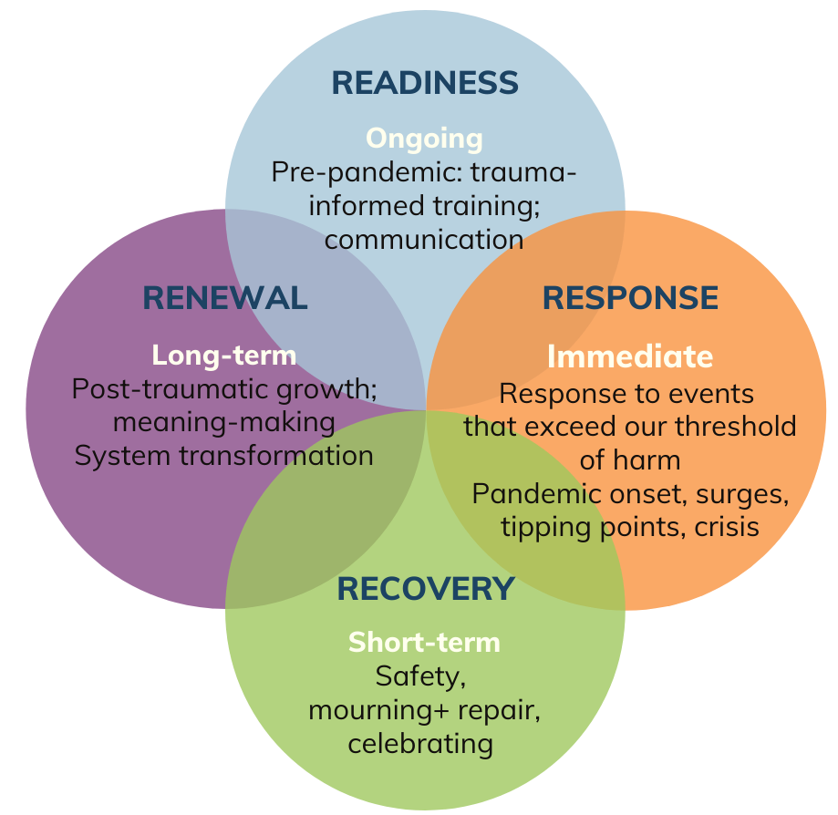
THE 4 R’S
Readiness, Response, Recovery, and Renewal
We may be in many phases at once and may circle through phases. What is predictable, is preventable and in this spirit, the 4 R's give us a general roadmap to what we may experience in a school crisis, but also these are not linear, and our experiences are unique.
Notes:
Timing: 1 min
Say: Let’s take the concepts we’ve just explore and situate them in the frame of crisis - specifically recovery and renewal. This is the grounding framework for the weeks and months after “the big thing” happens, and involves intentional support and care in a way that attends to the stress, trauma, and grief response that continue to surface. These are not linear, but overlaps and intersect over time.

Slide 25
READINESS
Ongoing
Trauma informed training, systems of communication; family engagement
RESPONSE
Immediate
Responses to events that exceed our threshold of harm; initial stabilization and attention to safety
Notes:
Timing: 1 minute
Say: We won’t linger here long, but I do want to touch on these elements of the 4 R’s. Readiness and response are the two domains most schools and institutions have plans for: how do we train our teams and prepare or organizations prior to a crisis, and what do we do in the immediate aftermath as we response to the crisis?

Slide 26
How do we know when we are individually and collectively moving toward recovery and renewal?
How activated are our nervous systems?
Are we still attending to immediate safety needs?
What is our capacity for reflection?
How safe do we feel - physically, emotionally, etc.?
How connected do we feel to those around us? How easy or challenging is it for us to trust others?
What kind of story are we telling ourselves and others about what has happened?
Notes:
Timing: 5 minutes
Say: It is in the days and weeks after the crisis response teams leave, the additional counselors depart, and the emergency resources are done that we often find out communities sitting in the “now what?” And when we move from crisis to crisis, it can be hard to know when we are beginning to recover from the event. We find power in being able to ask questions and place ourselves in a curious stance toward our experiences, to then identify when we might begin to shift toward recovery and renewal.
Read the questions on the slide.
These questions can help us determine if we are still in response mode - attending to basic needs, emotional safety - or if we are in a place to begin make meaning and reflect, indicating a shift into recovery and renewal.

Slide 27
RECOVERY: Three Observable Phases
Step 1:
Establish Safety & Stabilization
Step 2:
Remember, Mourn and Reconstruct the Story
Step 3:
Reconnection with Life, Engage in Social Action
(Herman, 1992)
Notes:
Timing: 2 minutes
Say: When we think about recovery, we see three observable phases as identified by researcher Judith Herman. First, is the establishing of safety beyond the tangible physical needs, be looking into social and psychological safety as well. We then enter a space of remembrance and mourning what used to be, before moving into the third stage, reconnection with life and social action. Let’s look at these in more detail.

Slide 28
STEP 1: SAFETY & STABILIZATION
PHYSICAL SAFETY
Protection from harm for students and staff
Clear safety procedures
Reduction of unnecessary triggers
EMOTIONAL SAFETY
Build emotion management skills
SOCIAL SAFETY
Build relationships with dependable, supportive others that can help when stressed
Prevent victimization and abuses of power
PREDICTABILITY
Routines and consistency
Predictable environment (posted procedures, classroom routines, etc.)
Explicit preparation for changes and transitions
Notes:
Timing: 3 minutes
Say: First let’s explore safety and stabilization by understanding the different domains of safety. Physical safety is the easiest to identify - food, shelter, lack of hazardous materials, the list goes on. But in recovery, we must think about safety from a more holistic lens. This looks also like creating emotional safety, or developing a comfort for moving through big emotions as they arise and responding in healthy ways to the emotions of others. We also see this in social safety, such as how dependable are my relationships or how are we addressing power dynamics? The interpersonal relationships and the social and hierarchical relationships play into establishing a sense of social safety. This also looks like predictability - having consistent routines and environments, providing clear communication or time to adjust to changes.
Ultimately as we consider safety, it is about establishing it internally and externally, and working to manage our own activated responses (think back to the 4 F’s) as we work with others to navigate theirs. It is important to note too that safety is relative - what makes one person feel safe many not necessarily make another person feel safe. For example, what a student might need compared to a teacher might feel at odds (a student feels disconcerted by an officer on campus because of past experiences with law enforcement in their family, while it may make an educator feel more secure). Additionally, discomfort and being unsafe are not the same thing. In fact, navigating discomfort is often vital for our growth. This might emerge more as you move into deeper reflection and is something to note as you prioritize actions to take after a crisis.

Slide 29
STEP 1: SAFETY & STABILIZATION
Developing Coping Mechanisms
Regaining a sense of power, control, connection
Identifying ways to metabolize emotions
Evidence based programs & practices
Developing self-awareness & attunement
Knowing and being known; loving and being loved
Trauma Practice: Tools for Stabilization & Recovery (Baranowsky, Gentry & Schultz, 2010, 2nd Ed.)
Notes:
Timing: 5 minutes
Say: Continuing to consider safety and stability, there are different ways we can approach this strategically as crisis leaders and crisis navigators. Each of these elements are important components to establish that deeper understanding of safety and empowering individuals in our systems impacted by crisis to continue to recover. Let’s take a look at each one:
Developing coping mechanisms is about internal safety as individuals and learning tools, like breathing techniques, reframing and more to support self-regulation.
Crisis take away people's sense of agency, and so finding ways for people to regain a sense of power, control, connection is vital to recovery. Practices like informed consent, participatory decisions, or collaborative workgroups can help people find that control and connection.
Beyond coping mechanism, identifying ways to metabolize emotions helps people experience recovery by not denying the validity of what they feel, but empowering them to navigate it. Young people experiencing anger or flight responses might like to run around a track to regulate, or students falling into hopelessness or freeze response may benefit for journaling or mindful practices.
To do this, it also involved developing self-awareness & attunement - When I feel angry, how to do I know it is anger? What does that feel like? And by knowing, I can respond to it in a more helpful way.
The next one, knowing and being known; loving and being loved seems self-explanatory, yet it communicates the importance of social and psychological safety. Having spaces where the fullness of who we are is seen and cared for is powerful in the recovery process, especially in the face of mistakes.
From a clinical standpoint, evidence based programs & practices also have a place to play in safety. Yet, as we lean into that structure, it is also importance to allow space for emergence and community-based wisdom to surface, especially in the context of recovering from a community crisis.
Again, this is about seeing safety as deeper than just physical needs, and the first crucial step toward meaningful recovery.

Slide 30

STEP 2: REMEMBRANCE & MOURNING
Holding Space: “offering the experience of being heard without fixing, solving, or treating”
Tell stories and sharing memories
Legitimizing emotions
Self-attunement
Co-regulation
Honor proximity to loss
Recovery leaders plan for what spaces need to be held together as a whole, and which members need differentiated recovery spaces/supports.
Adapted from David Kessler
Notes:
Timing: 3 minutes
Say: The second phase in recovery is remembrance and mourning, where we begin to make sense of our experience in the crisis and start telling the story of what happened. This can be both individual and collective - we will privately and personally remember while also sharing publicly, especially as safety is established.
Critically in this phase as school crisis leaders, we can engage in the practice of “holding space” - allowing people in our school to be heard without trying to fix, solve, or treat the emotions and experiences. What this looks is:
Tell stories and sharing memories
Legitimizing emotions
Self-attunement
Co-regulation
Honor proximity to loss
It is also important to note that as we engage in the listening, holding space, memorializing - different people may need different spaces. If a school community experiences a student death by suicide, the student’s teacher and immediate friends would need a different grief and processing approach than the school as a whole, for example.

Slide 31
STEP 3: RECONNECTION
Reinvention of the self, renewed hope and possibility
Social action, community justice
You are more than the thing(s) that have happened to you
What parts of yourself do you want to let go of?
What skills or strengths have you gained from surviving this loss that you want to hang onto?
Establishing goals and vision for how you want your life (or school or community) to be
Participating in organizing efforts
Considering whether you have a purpose connected to what you have survived
Notes:
Timing: ~5 minutes
Say: We now move into Step 3: Reconnection. In Judith Herman’s framework, this is the phase where survivors begin to reclaim agency and build new meaning in their lives after trauma. David Kessler expands on this idea in the context of grief—this is the space where people begin to find meaning and move forward without leaving their loved ones or experiences behind.
For schools and communities, this is where we support students, staff, and families in seeing themselves as more than the worst thing that’s happened to them. We start asking: What do we want our lives, our schools, our relationships to look like now?
Some reflective questions you might use in a school circle, staff meeting, or with individuals could include: What parts of yourself do you want to let go of? What strengths or skills have you gained from surviving this loss that you want to carry forward?
Reconnection is also about action. Social action, in particular, can be a powerful part of healing—whether that’s creating a memorial, forming a student-led advocacy group, or engaging in restorative justice. As the SCRR project reminds us, healing is not only individual, but collective and systemic.
Facilitation Notes:
Offer examples:
For example, after the death of a student, a school community might create a peer mentorship program in that student’s memory, transforming pain into purpose.
After a wildfire, a student might say, ‘I want to become an environmental engineer,’ because of what they’ve experienced. That’s reconnection.
Encourage leaders to personalize this stage: Ask them to think of their own community’s unique strengths—cultural, spiritual, relational—that can help guide reconnection and renewal.

Slide 32
Chat + Consider…
As you reflect on creating safety and stability, what might that look like in your context or role or setting?
How might you address the relativity of safety, while still attending to procedures and policies that are coherent and predictable?
Step 1:
Establish Safety & Stabilization
Step 2:
Remember, Mourn and Reconstruct the Story
Step 3:
Reconnect with Life, Engage in Social Action
8 minutes in breakout rooms
Notes:
Timing: ~10 minutes
Say: I want to give us space to process the elements of recovery discussed here. In small groups, consider each of the steps and how you see them emerge as you’ve navigated the weeks after a crisis. Where did your school community succeed? Where might more growth be needed?
You can frame it around these questions zooming in on safety, or explore the other steps that feel important to you:
As you reflect on creating safety and stability, what might that look like in your context or role or setting?
How might you address the relativity of safety, while still attending to procedures and policies that are coherent and predictable?
Take about 8 minutes to discuss in small groups, and we will debrief when we come back together.
Facilitation Notes:
Feel free to be mobile around the room or pop into breakout rooms as people discuss.

Slide 33
RENEWAL: Toward Meaning-Making, Healing & Change
Create Structural Witnessing
Collective Reflection
Center Significant Relationships
Renewed Commitment to the Work
Foster Healing-Centered Cultures
Be Prepared to
Sit in the Sticky Stuff
Encourage Individual & Collective Storytelling
Notes:
Timing: ~7–8 minutes
Say: Next, let’s turn our lens toward the Seven Elements of Renewal identified by the School Crisis Recovery and Renewal Project. These elements are practical, grounded ways to support recovery after a crisis—ways that center justice, relationships, and collective healing.
These aren't steps you move through in order. Think of them more like conditions we try to nurture across a school community after a crisis, whether that’s a student death, a natural disaster, or an act of violence. Many of these ideas are influenced by Judith Herman’s understanding of recovery as relational and empowering, and David Kessler’s emphasis on meaning-making after loss.
Let’s break them down briefly:
Create Structural Witnessing is how we build systems where people feel heard without needing to be "fixed." For Example: A school sets up regular, facilitated listening circles for staff and students to share without interruption or judgment.
Center Significant Relationships - means we recognize that both healing and harm happen in relationships, and we want to ensure that we honor the importance of healing connections. Example: After a student death, a principal prioritizes time for staff connection, peer support groups, and family-school check-ins.
Foster Healing-Centered Cultures shifts the way we do school community - we purposefully embed healing into daily school culture—not just responses. Example: Integrate rituals like morning check-ins or community circles into classrooms; offer project-based learning tied to justice or resilience.
Encourage Individual and Collective Storytelling About the Crisis means we support people in making meaning through shared narratives. Example: Invite students to create art or write letters that express what the crisis meant to them and how they’ve grown.
Be Prepared to Sit in the Sticky Stuff Where There Are More Questions Than Answers invites us to lean into hard, often uncomfortable inquiry. Example: A leadership team reviews their crisis response and asks, "Who was well served—and who wasn’t?" and uses those insights to make equity-based changes.
Renewal Itself Can Foster a Renewed Commitment to the Work - We see this all the time in the caring professions - we let the process of renewal deepen our purpose. Example: A school recommits to anti-racist teaching practices after seeing how some students were disproportionately impacted by the crisis.
Engage in Collective Reflection to Fuel and Inform Crisis Readiness represents the cyclical way that renewal also funnels back into readiness. We can learn from every phase of a crisis to improve future responses.
Example: After recovery, school teams hold debrief sessions, updating their crisis plans based on lived experience.
Each of these elements of renewal inspire us to lean into coping, meaning-making, resilience, post traumatic growth, and healing.

Slide 34
Questions to drive our trauma informed school system leadership
What underlying issues impacted the crisis? What ways would wholistic supports address that root cause?
Where is there need for deeper reflection?
Root Cause Focus
Who is defining the storytelling?
What outcomes do we see from the stories being told?
Whose stories are being centered and uplifted? Why?
Meaning Making
What does it look like to move forward without moving on?
How are we redefining ourselves and our organizations?
Restoration and Identity Shifts
Where might harm have been caused during response and recovery? How do we make it right?
How do people define healing as individuals? How do we create a collective acknowledgement or affirmation of that healing?
Repairing
Notes:
Timing: ~5 minutes
Say: But how might we better define post-traumatic growth and healing? We use this word a lot, and there are a few elements we might consider as we approach healing, as well as some guiding questions to consider deeper reflection as we seek to foster healing-centered cultures in our school communities, either as part of our readiness of as our renewal after a crisis.
We see four crucial elements to healing: identifying, naming, and working to address the root cause of the crisis; building purposeful narratives through meaning-making; considering who we’ve become in light of this crisis experience, either shifting or restoring elements of our identify based on what we learned about ourselves; and then repairing harm that may have been caused throughout the response or recovery process.
Review the questions for each element, pausing for a brief moment to allow people to silently reflect.

Slide 35
Chat + Consider…
Root Cause Focus
Of these elements of leadership work, which feels most resonant for you right now? Why?
Meaning Making
Identity Shifts
Repair
5 minutes large group
Notes:
Timing: ~5 minutes
Say: Considering each of these elements of healing, consider what you are experiencing in your own context. Which seems like it the most resonant, of the one that deserves the most attention?
Facilitation Notes: Depending on timing, you can have this be a turn-and-talk, a whole group share out, and individual journal, or a quick rhetorical exercise.

Slide 36
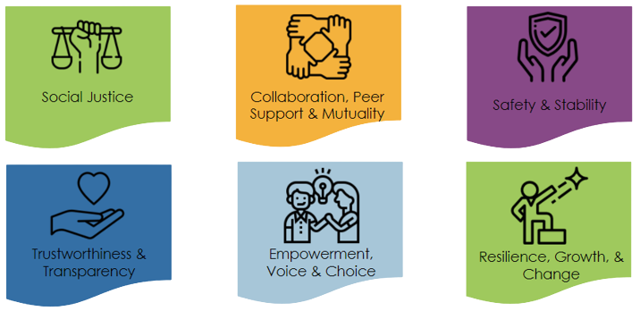
So, we’ve examined all this: What do we do with it in our classrooms?
Notes:
Timing: ~1 minute
Say: So now that we’ve explore trauma-informed principles, experiences within stress, trauma, and grief, as well as the elements of recovery and renewal - what might we do with it in our classrooms and in our school communities?

Slide 37
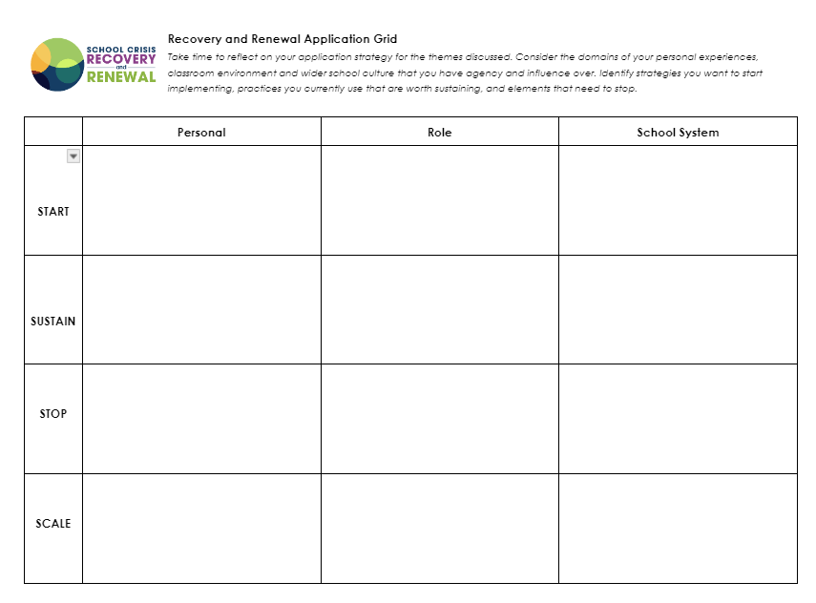
APPLICATION GRID
Post session offering: Identify actionable steps you might take to apply this content
Notes:
Timing: ~2 min
Say: I want offer a way you can commit to taking this learning back with you to your school community. This reflection grid invites us to look through the lenses of various roles we hold - our individual practice, our immediate team, and our broader system - and those roles can take whatever shape fits your experience. Perhaps the larger systems is your district, and your team is the crisis response team or the high school principles or your grade level team. The goal is to have you scale out from personal to the broader groups you interact with.
For each role, you will reflect through the 4 S’s:
Start: something you are not yet doing that you want to start implementing (maybe an element of renewal or attending to social safety instead of just physical safety)
Stop: a habit or practice you want to stop doing that does not support implementing trauma-informed recovery and renewal
Sustain: something you are currently doing that you want to continue
Scale: something you are currently doing that you want to expand - maybe a personal practice that can scale to your immediate team, for example.
Facilitation Notes:
If time, you can create space for participants to work on this tool, either individually or with someone else from their school site. If not, this can be shared as a reflection resource for them to explore in the coming days.
Link to grid, either share in the chat or print for participants: https://docs.google.com/document/d/1T4AojgFmSnlcAXmex3QeeGxNR1IYzS85ZpowO_ywRk0/copy

Slide 38
APPLICATION GRID
 | Individual Role | Immediate Team | School System/Org
Stop | Viewing student behavior as a character flaw.
Sustain | Self-care by not responding to emails after 5pm | Circle discussions to check-in.
Start |  | Implementing quick brain science lessons/videos as bellringer | Trauma-informed committee with staff, parents and students
Notes:
Timing: ~3 minutes
Say: Here are some examples of what this might look like. You may not have the entire grid filled out, but try to look for one of each: one for each role and one for each of the 4 S’s. Documenting these practices and committing to revisiting them is an important approach to ensure we actually make the changes we feel in the moments after a training but that can get lost when we are back in the busyness of our school sites.
Facilitation Notes:
If time, you can create space for participants to work on this tool, either individually or with someone else from their school site. If not, this can be shared as a reflection resource for them to explore in the coming days.
Link to grid, either share in the chat or print for participants: https://docs.google.com/document/d/1T4AojgFmSnlcAXmex3QeeGxNR1IYzS85ZpowO_ywRk0/copy

Slide 39

CLOSING AFFIRMATION
in the end i found that the universe
i longed to connect with
lived within me
there was no need
to look anywhere else
tor the answers
as long as life was in me
Kaur, R. (2024). Milk and honey: 10th anniversary collector's edition. Andrews McMeel Publishing.
Image via Creative Commons license
Notes:
Timing: ~1 minute
Say: To close, I want to offer us a poem as a reminder of the power of who we are in the important work we do as school crisis leaders. Often we seek the “right” thing to do, and forget that we ourselves are the right people for this work. The poem is from Rupi Kaur in her book milk & honey:
in the end i found that the universe
i longed to connect with
lived within me
there was no need
to look anywhere else
tor the answers
as long as life was in me
Citations:
Kaur, R. (2024). Milk and honey: 10th anniversary collector's edition. Andrews McMeel Publishing.
Image via Creative Commons license

Slide 40
THANK YOU!
Notes:
Say: Thank you so much for your time, energy, and efforts - not just today, but in the work you do day in and day out. It is so so important, and you are the right person for this work.

Slide 41
References
Baranowsky, A. B., Gentry, J. E., & Schultz, D. F. (2010). Trauma practice: Tools for stabilization and recovery (2nd ed.). Hogrefe & Huber Publishers.
Herman, J. L. (1992). Trauma and recovery: The aftermath of violence—from domestic abuse to political terror. Basic Books.
Kaur, R. (2024). Milk and honey: 10th anniversary collector's edition. Andrews McMeel Publishing.
Kessler, D. (2019). Finding meaning: The sixth stage of grief. Scribner.
Salzman, J. B., & Salzman, J. (2015, February 27). Just Breathe [Video]. YouTube. https://www.youtube.com/watch?v=RVA2N6tX2c
Dorado, J. & Dolce, L.. (2019). Trauma-Informed Systems 101 [Presentation]. Trauma Transformed.
Walker, P. (2013). Complex PTSD: From surviving to thriving: A guide and map for recovering from childhood trauma. CreateSpace Independent Publishing Platform.

Slide 42


Contact Info
Email: SCRR@cars-rp.org
Phone: (888) 597.0995
Website: www.schoolcrisishealing.org
Website: traumatransformed.org
Get social with us!
Facebook: @scrr.project
Instagram: @scrr_project
Twitter: @scrr_project

Slide 43



OUR SCRR Project TEAM
The SCRR Project is a collaborative effort between The Center for Applied Research Solutions (CARS) and Trauma Transformed (T2) and strongly informed by partnership with the National Center for School Crisis Bereavement and our team of school crisis recovery and renewal experts from across the country.
Funded by SAMHSA, we are part of the National Child Traumatic Stress Network.
Notes:
Center for Applied Research Solutions (CARS)
Leora, Project Director; Niki Magtoto, Project Manager; Oriana SCRR Field Coach; Kristi Silva, Evaluation Coordinator
Partner: Trauma Transformed (T2)
Jen Leland, Field Director; Anh Ta, Antoine Moore, Darryn Green & Francesca Osuna, Brianna Young, SCRR Field Coaches
Senior Advisement: Dr. David Schonfeld, National Center for School Crisis and Bereavement; Evaluation consultation with Tori Stuart-Cassel, EMT
A Team of School Crisis Recovery & Renewal Experts (aka Coaches)
An NCTSN Category II Site

Slide 44

DISCLAIMER
This training is offered through the National Child Traumatic Stress Network (NCTSN) and The School Crisis Recovery and Renewal (SCRR) and is funded by the Center for Mental Health Services (CMHS), Substance Abuse and Mental Health Services Administration (SAMHSA), U.S. Department of Health and Human Services and jointly coordinated by the University of California, Los Angeles, and Duke University, and is administered by the Center for Applied Research Solutions (CARS). The views, opinions, and content expressed in this presentation do not necessarily reflect the views, opinions, or policies of SAMHSA.

